Slide 1
WP10 – Virtual Research Environment –
Introduction to the VRE
WP10 team

Slide 2
Outline
SDC VRE – Short progress summary
Introduction to the components
Organisation of training

Slide 3
1. Short progress summary

Slide 4
SeaDataClouds VRE needs to:
  Facilitate collaborative and individual research
  Combine data with subsets from other data resources, such as the ingested collections
  Have a high capacity and performance for data processing and state-of-the-art web visualisation services

Slide 5
  Respect privacy of users and differences in data policies. Differentiated users, different access to data and data products.
  Be possible to configure virtual work spaces for individuals or groups to work on specific projects, including setting up of dedicated pools of data
  Allow producers to decide whether their outcomes will be shared in the public domain or stay private
  Be based and hosted on EUDAT’s infrastructure based on it B2-… service platforms

Slide 6

Aim is to support 5 versatile use cases:
SeaDataNet Temperature and Salinity water column analysis
EMODNET - Chemistry, same for bio-geo-chemistry
SeaDataNet Biology Quality Assessment
EMODNET - HRSM, DTM processing
Processing and visualising data sets

Slide 7
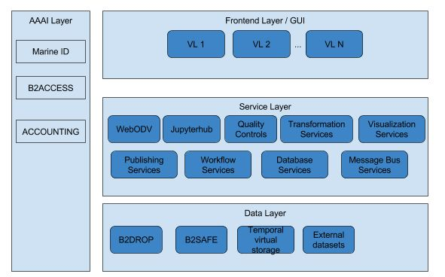
SDC VRE Architecture – level 1

Slide 8
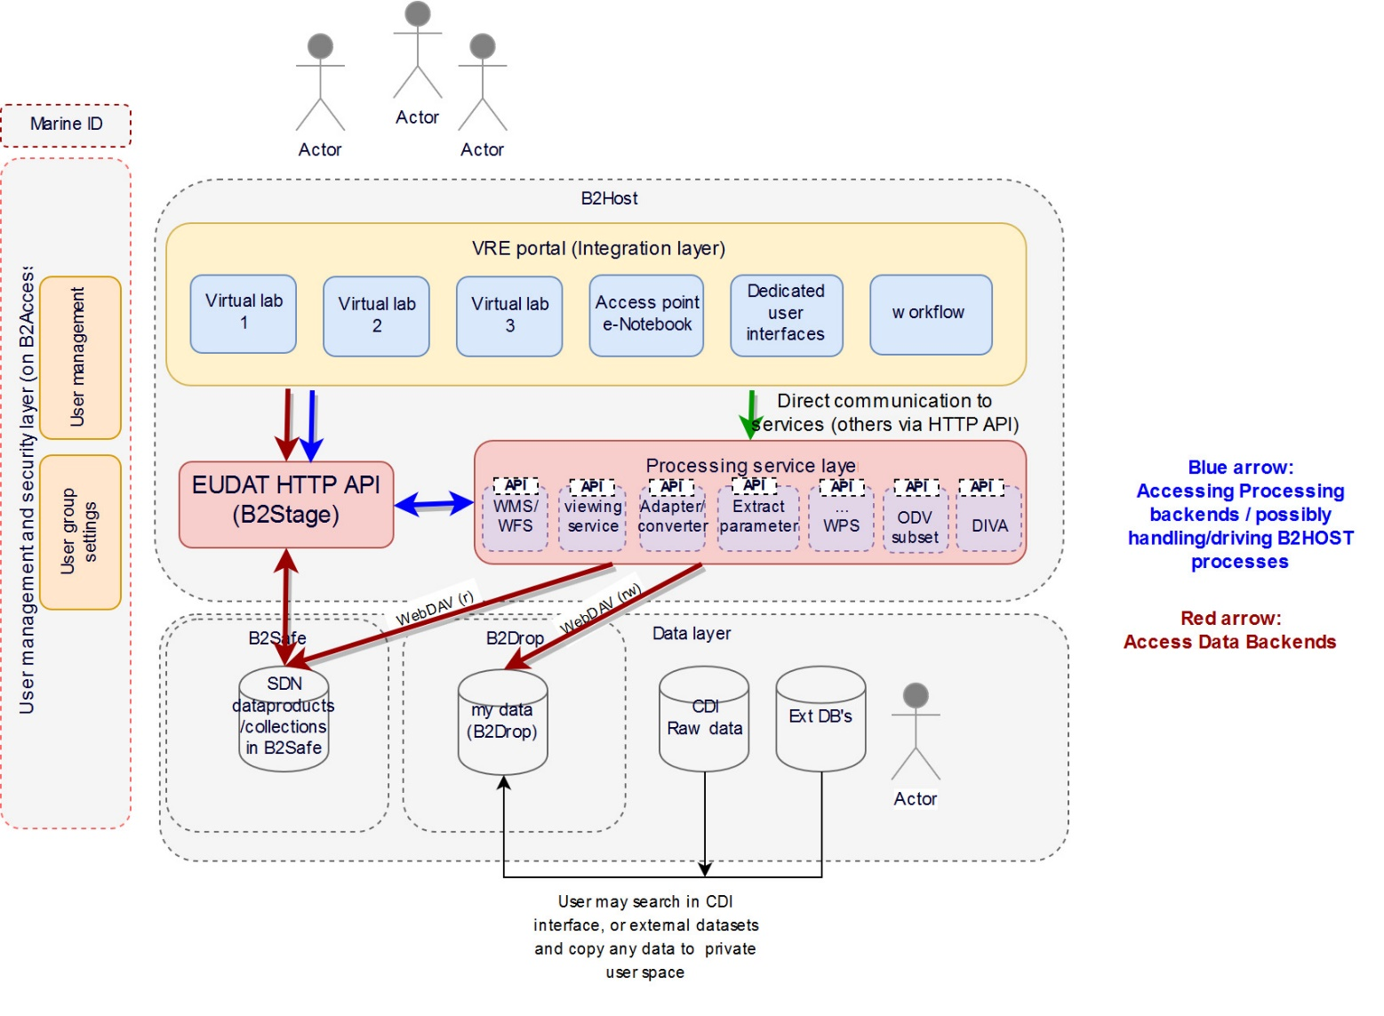
SDC VRE Architecture – level 2

Slide 9
First functions targeted of T/S
(abstract of total use case!)
log in with single sign on | B2ACCESS + Marine-ID
integration GUI development | Javascript library
apply water column obs quality control with friendly data editor and save result, | webODV
advise data centre of the regional quality control
be advised of quality control result (email of log of changes/anomalies sorted per DC) | email
configure DIVA interpolation | Jupyter + DIVA library
apply DIVA interpolation, send notification (email) when processing is completed
visualize interpolation result together with original observations of other observations
extract and view profiles, time series, hovmuller out of the interpolation result
publish dataset results (metadata and data), get a DOI | oceanBrowser+ERDDAP+sextant-dataCite

Slide 10
2. Introduction to components
Some highlights

Slide 11
Components
Dashboard
My workspace
WebODV
DIVA
Biological QC
Additional visualization

Slide 12
3. Organisation of VRE sessions

Slide 13
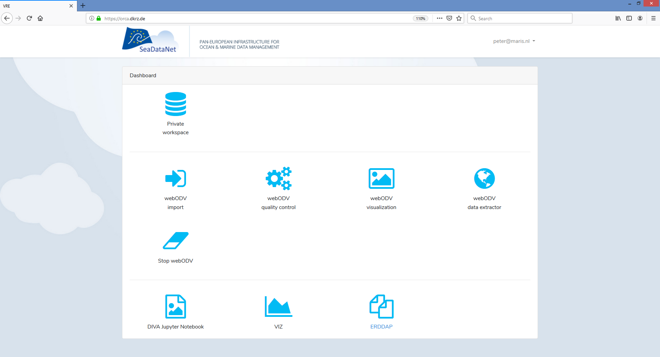
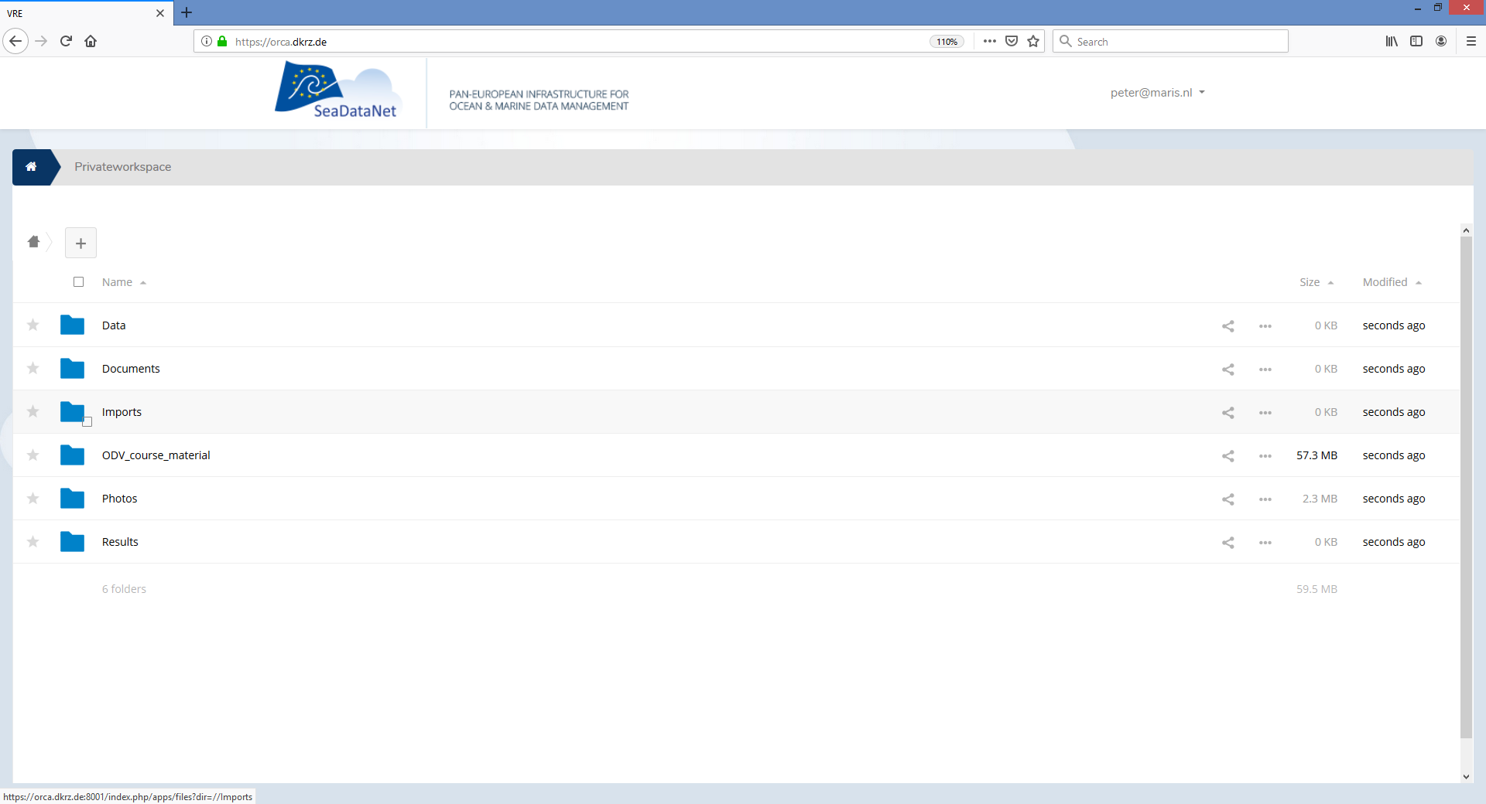
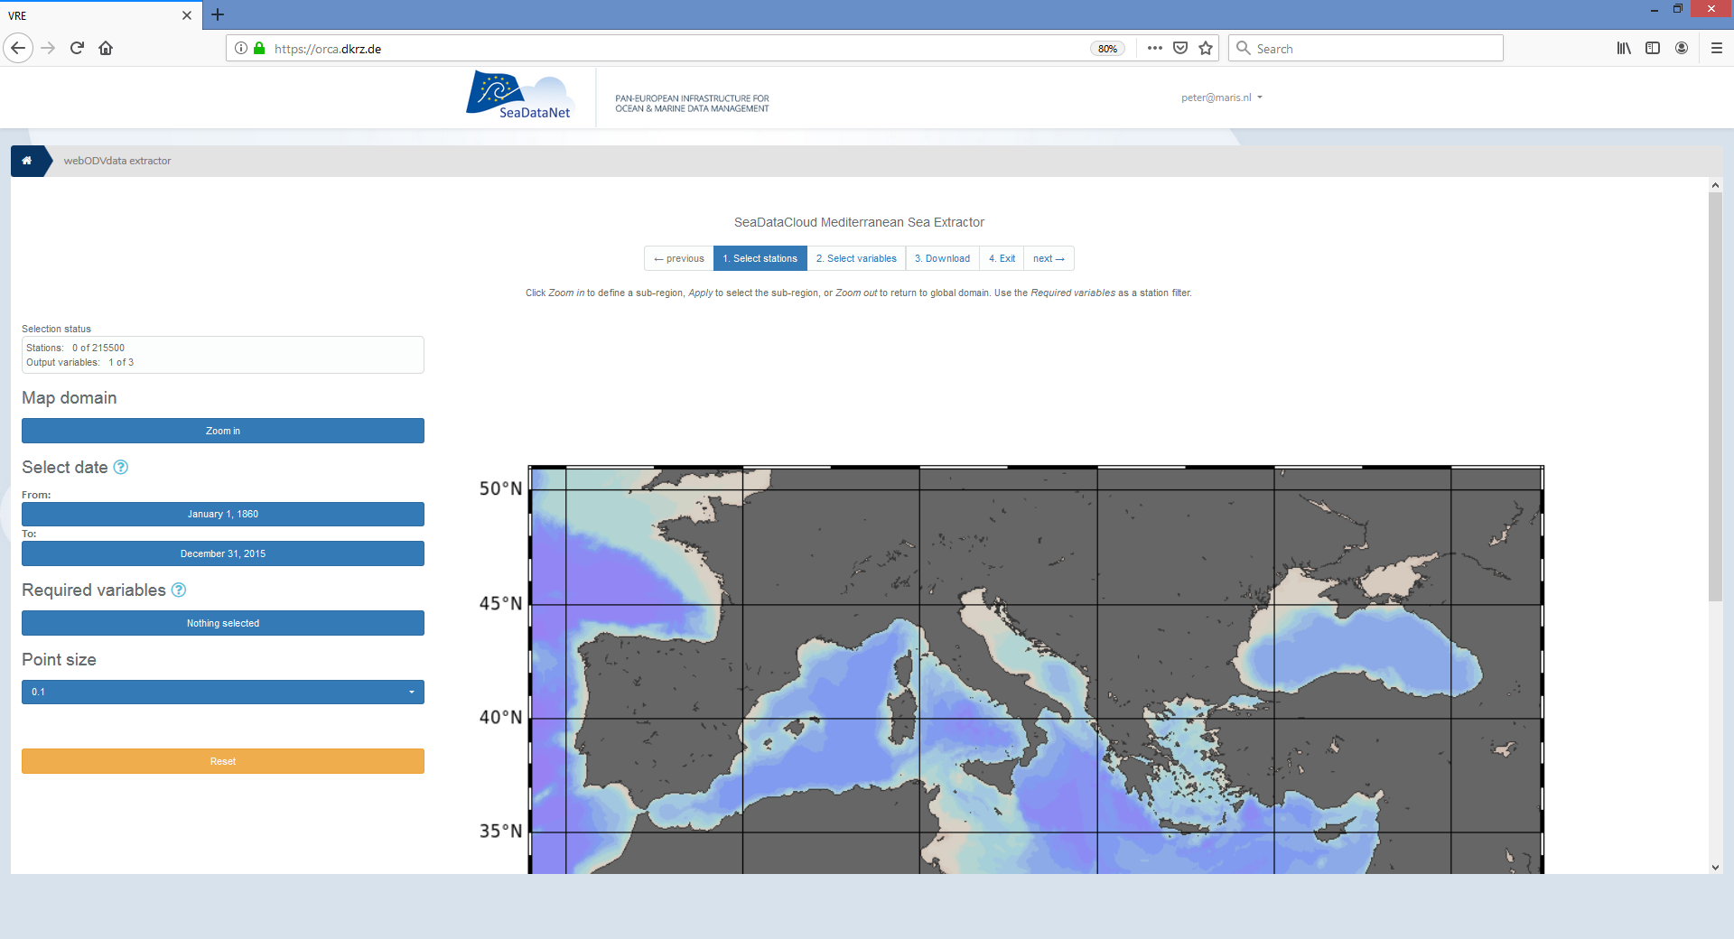
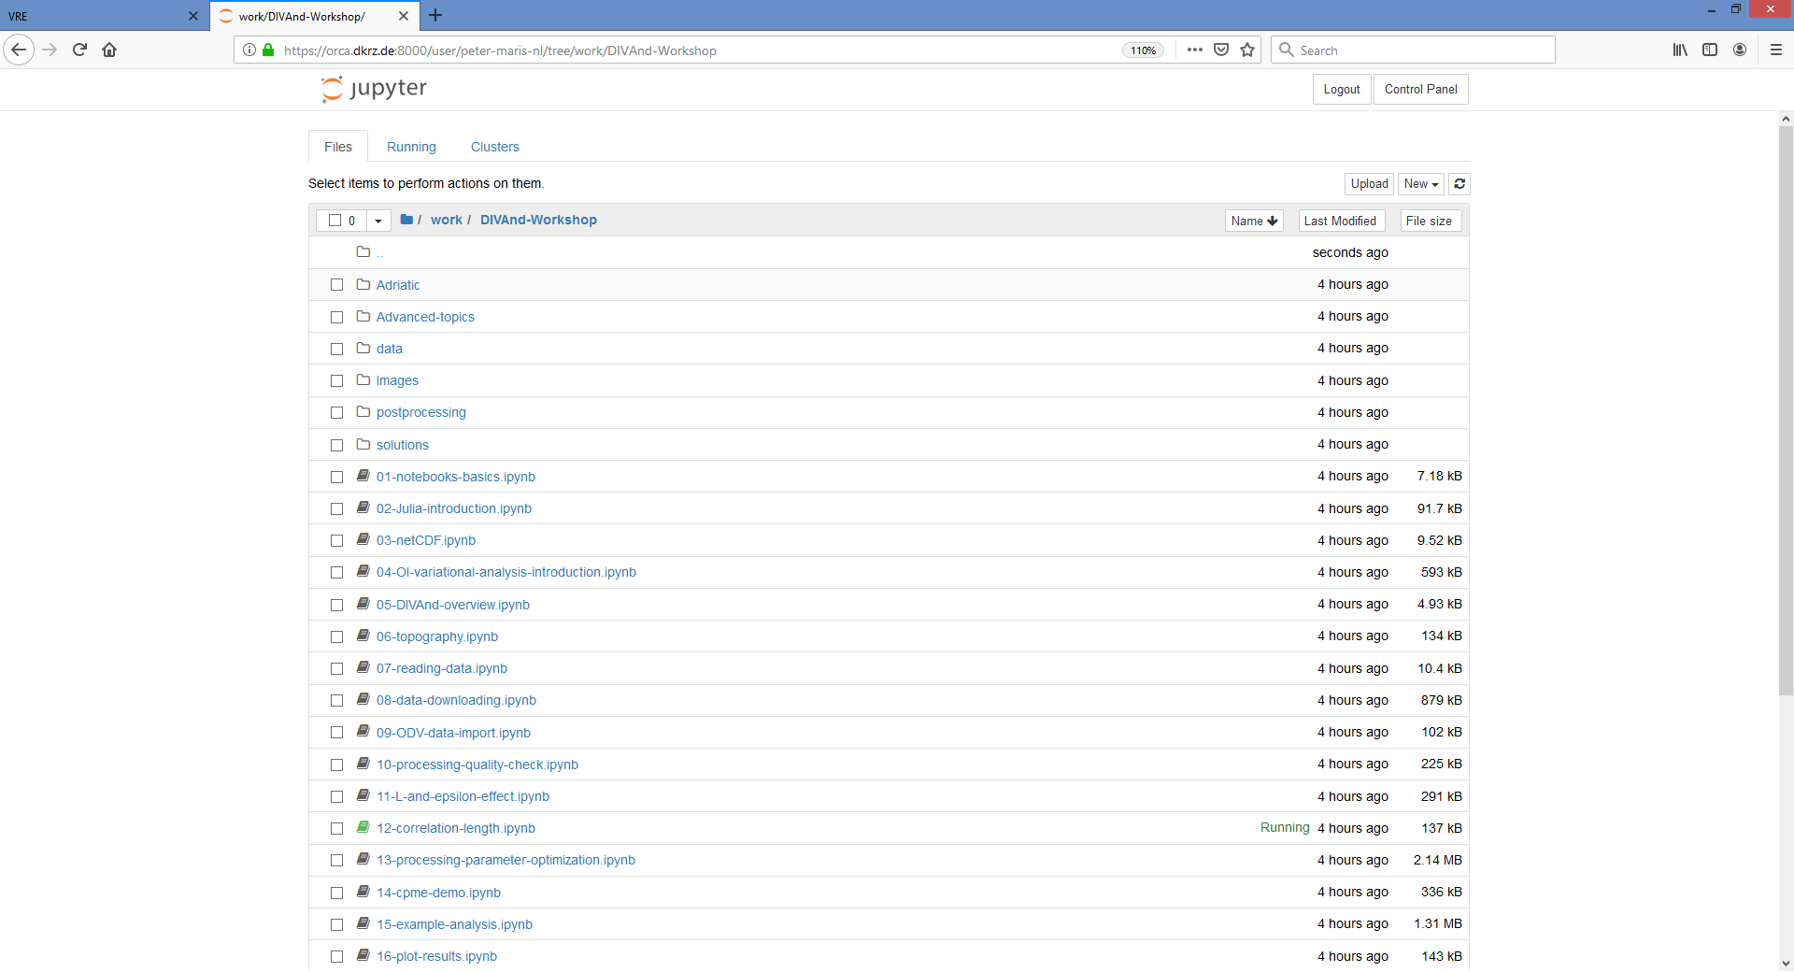
Sessions
Day 1:
  WebODV (Online)
  QC for biological data (offline)
Day 2:
  DIVA (Online)
  Additional online visualization
Organisation:
  One tutor per session
  Two students per laptop
  First demo, then training module
  Room for question and answers
  Feedback at end of the day

Slide 14
Some actions to start with
Go to https://orca.dkrz.de
Login with your Marine-ID
Open the workspace
(this may take some time first time)
Upload/download some files
(no spaces in file names)

Slide 15
Login to VRE
Some help from GRNET

Slide 16
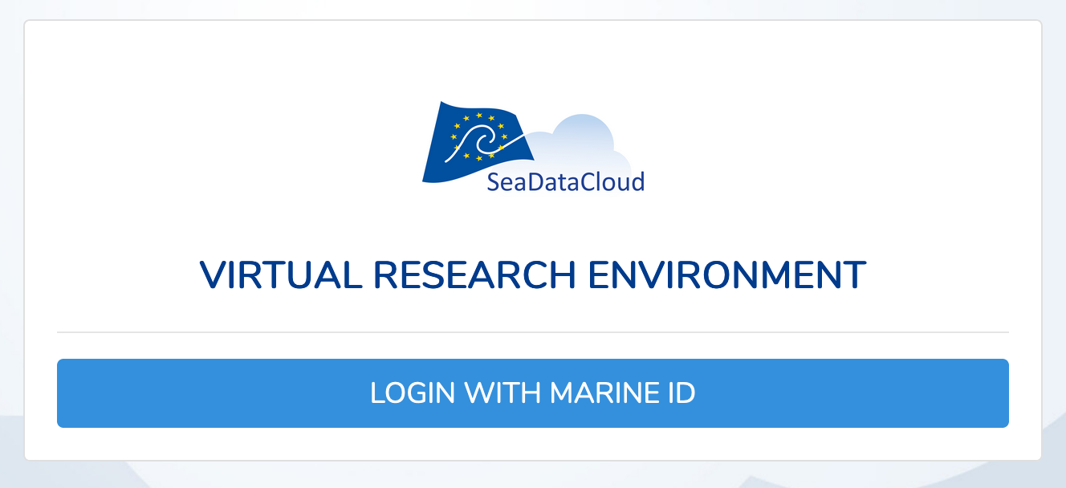
Login to VRE via your MARINEiD
Go to https://orca.dkrz.de/ and click on “Login with MarineID” button.

Slide 17
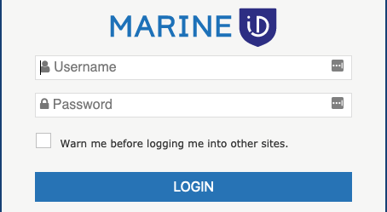
Login to VRE via your MARINEiD
Enter your MARINEiD credentials

Slide 18
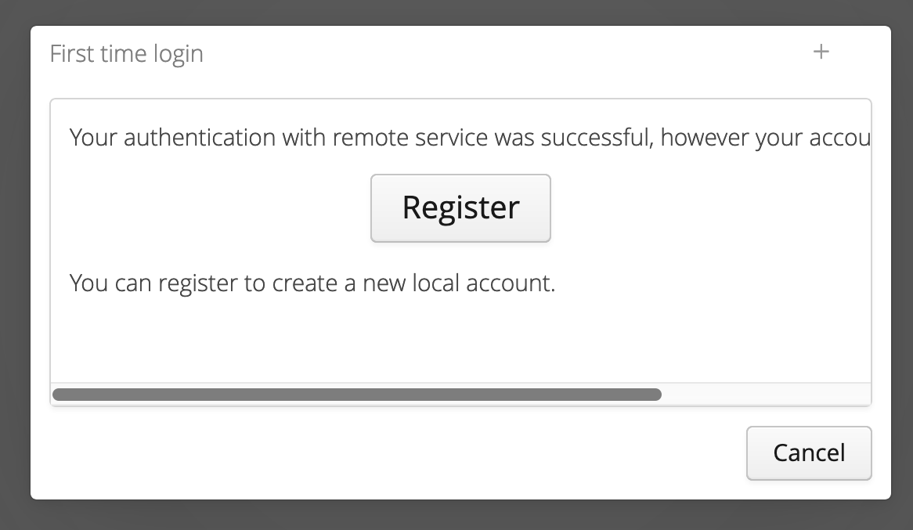
Login to VRE via your MARINEiD
Is it the first time you are using this type of login? Then you have to register
No worries it’s only a one time process

Slide 19
Why should I register?
This is a registration to give you access to certain groups and respective services.
Register once and you will have permissions to use the services you need.

Slide 20
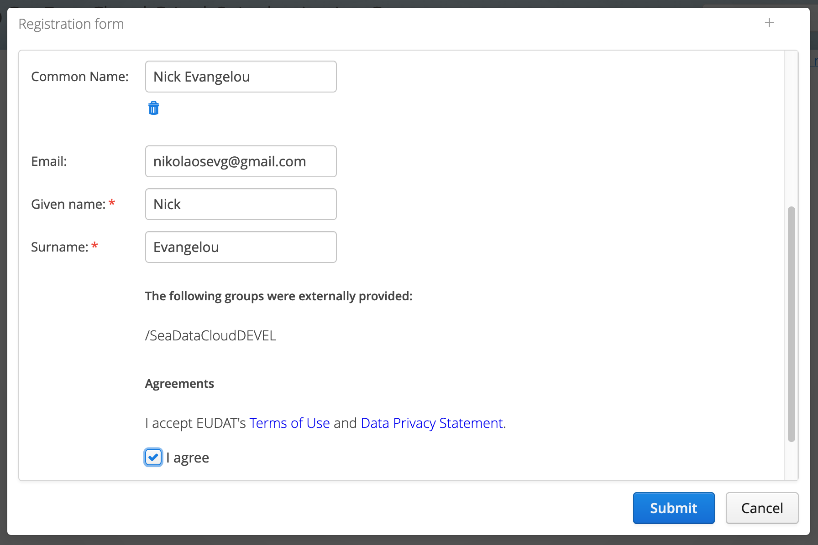
Is this your first time
Apply the form

Slide 21
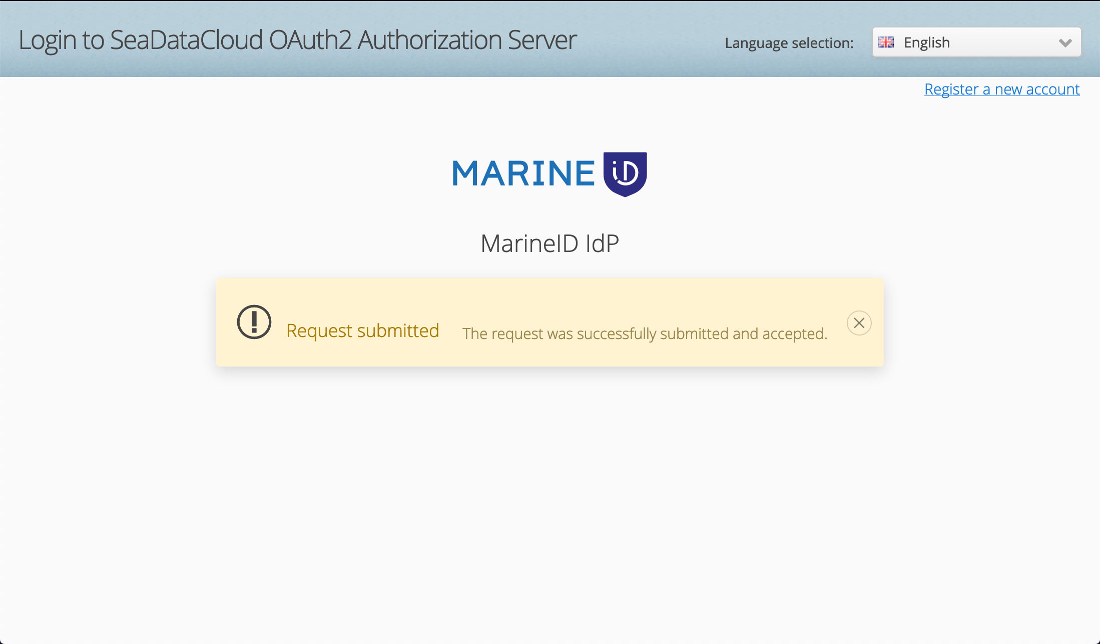
Is this your first time
Registration completed

Slide 22
Now ready to move into the sessions.
Questions, or suggestions?

